Slide 1

Introduction to Provisioning
UNIT I
DEPLOY
the application
How infrastructure is created, set up and handed over — and how that differs from configuration management and deployment.
CONFIGURE
the software
PROVISION
the infrastructure

Slide 2
Unit Roadmap
UNIT I · INTRODUCTION TO PROVISIONING
01
What is provisioning?
05
Why provisioning is not configuration management
Basic definition · Software definition · Types
Different jobs, different tools
02
Concepts of provisioning
06
Provisioning tools and test machines
Lifecycle · Infrastructure as code · Idempotency · Capacity
Terraform · Vagrant · The test loop
03
Why provisioning should be exclusive
07
Deployment
One owner for every resource
Strategies · Its relationship with provisioning
04
Configuration management
08
Review
Desired state · Push vs pull · CM tools
Activity · Quiz · Glossary · Takeaways

Slide 3
Learning Outcomes
UNIT I · INTRODUCTION TO PROVISIONING
By the end of this unit, you will be able to:
DEFINE
EXPLAIN
JUSTIFY
provisioning in general and in software terms, and name its main types.
infrastructure as code, declarative vs imperative, idempotency and immutability.
why provisioning should be exclusive, with three clear reasons.
COMPARE
DISTINGUISH
APPLY
configuration management tools: Ansible, Puppet, Chef and Salt.
provisioning from configuration management, and both from deployment.
a provisioning workflow: Terraform for infrastructure, Vagrant for test machines.

Slide 4
What Is Provisioning?
01
PART 01
Basic definition · Software definition · Types of provisioning

Slide 5
Provisioning: The Basic Definition
01 · WHAT IS PROVISIONING
IN EVERYDAY ENGLISH
THE ANALOGY, MAPPED
To provision is to supply something with everything it needs before it is used.
Provisioning a ship | Provisioning IT
Food and water | CPU and memory
Fuel | Power and network connectivity
Cargo hold | Storage
Crew passes and cabin keys | User accounts and permissions
The captain’s checklist | A provisioning script or template
Before a long voyage, a ship is provisioned: food, water, fuel and equipment are loaded so the crew can work without stopping.
IT works the same way: resources are prepared before the workload arrives.

Slide 6
Provisioning: The Software Definition
01 · WHAT IS PROVISIONING
“Provisioning is the process of creating and setting up IT infrastructure, and includes the steps required to manage user and system access to various resources.”
— Red Hat, “What is provisioning?”
01 · CREATE
02 · SET UP
03 · GRANT ACCESS
Servers, storage and networks are brought into existence.
The operating system, base settings and connectivity are put in place.
Users and systems get exactly the permissions they need.
Provisioning comes first: Red Hat calls it “an early stage in the deployment of servers, applications, network components, storage, edge devices, and more.”

Slide 7
01 · THE NIST CLOUD DEFINITION
“Cloud computing is a model for enabling ubiquitous, convenient, on-demand network access to a shared pool of configurable computing resources (e.g., networks, servers, storage, applications, and services) that can be rapidly provisioned and released with minimal management effort or service provider interaction.”
NIST Special Publication 800-145, The NIST Definition of Cloud Computing (2011)

Slide 8
Types of Provisioning
01 · WHAT IS PROVISIONING
Server provisioning
Storage provisioning
Network provisioning
Setting up a physical or virtual server: OS, software, network and storage connections.
Allocating disk capacity to servers and applications: volumes, file shares and buckets.
Setting up routers, switches and firewalls; assigning IP addresses and subnets.
User provisioning
Service provisioning
Cloud provisioning
Creating accounts and granting permissions. Taking them away is de-provisioning.
Setting up an IT service for end users, such as email or a managed database.
Creating a cloud environment: accounts, networks, virtual machines and managed services.

Slide 9
On-Premises vs Cloud Provisioning
01 · WHAT IS PROVISIONING
Aspect | On-premises | Cloud
Getting a server | Buy, rack and cable hardware, then install the OS | Call an API, run a CLI command or click in a console
Lead time | Days to weeks | Minutes
Cost model | Up-front purchase (capital expense) | Pay as you go (operating expense)
Scaling | Plan capacity months ahead | Scale out and in on demand
Typical tools | PXE boot with Kickstart, Cobbler, Foreman, MAAS, VM templates | Terraform, CloudFormation, Bicep, cloud CLIs
Many organisations run both — a hybrid cloud. Tools such as Terraform can provision VMware vSphere machines on-premises as well as cloud resources.

Slide 10



Cloud Provisioning Models
01 · WHAT IS PROVISIONING
Advanced provisioning
Dynamic provisioning
User self-provisioning
The customer signs a contract, and the provider sets aside the agreed resources in advance.
Resources are added and released automatically as demand rises and falls.
Customers create resources themselves through a portal, CLI or API, and pay for what they use.
Example: reserved or dedicated capacity for a fixed term.
Example: an auto-scaling group adding VMs during a traffic spike.
Example: a student launching a VM from the cloud console in minutes.

Slide 11
Concepts of Provisioning
02
PART 02
Lifecycle · Infrastructure as code · Declarative vs imperative · Idempotency · Mutable vs immutable · Capacity

Slide 12


The Provisioning Lifecycle
02 · CONCEPTS OF PROVISIONING
Capacity returns to the pool; the cycle starts again
1
2
3
4
5
6
Request
Approve
Allocate
Prepare
Hand over
De-provision
A team asks for resources: a ticket, a pull request or a portal form.
Policy, quota and budget are checked before anything is created.
Compute, storage, network and IP addresses are reserved.
The OS image, base settings and access are put in place.
Health checks pass; the requester gets access and starts using it.
When no longer needed: reclaim resources, revoke access, wipe data.
Automation shrinks steps 2–5 from days to minutes: the request becomes a pull request, approval becomes a code review, and the tool does the allocating and preparing.

Slide 13
From Manual Steps to Infrastructure as Code
02 · CONCEPTS OF PROVISIONING
MANUAL PROVISIONING (“CLICKOPS”)
INFRASTRUCTURE AS CODE (IAC)
Click through consoles and type commands by hand
Slow, and every server ends up slightly different
Hard to repeat: the steps live in someone’s head
No record of who changed what, or why
Infrastructure is described in machine-readable files, kept in version control and applied by a tool.
Reviewed like code, through pull requests
Same input, same result — every time
Rebuild an environment straight from the repo
FIVE ADVANTAGES OF IAC
Speed
Consistency
Version control
Reusable modules
Fast recovery

Slide 14
Declarative vs Imperative
02 · CONCEPTS OF PROVISIONING
IMPERATIVE — THE HOW
DECLARATIVE — THE WHAT
You list the steps; the tool runs them in order.
You describe the end state; the tool works out the steps.
create-servers.sh
main.tf
# create three web servers
aws ec2 run-instances \
--image-id ami-xxxxxxxx \
--instance-type t3.micro \
--count 3
# three web servers, always
resource "aws_instance" "web" {
count = 3
ami = "ami-xxxxxxxx"
instance_type = "t3.micro"
}
Run it twice: 6 servers
Run it twice: still 3 servers
Also imperative: shell scripts, cloud CLIs, Chef recipes
Also declarative: CloudFormation, Puppet, Kubernetes manifests

Slide 15
Idempotency
02 · CONCEPTS OF PROVISIONING
An operation is idempotent when running it once or a hundred times leaves the same end state.
NOT IDEMPOTENT
IDEMPOTENT
mkdir /data
mkdir -p /data
Fails on the second run: the folder already exists.
Creates the folder only if it is missing.
echo "x" >> app.conf
lineinfile: line="x"
Adds a duplicate line on every run.
Ansible makes sure the line is present exactly once.
aws ec2 run-instances --count 3
count = 3
Three more servers on every run.
Terraform keeps exactly three, however often it runs.
useradd deploy
user: name=deploy state=present
Errors if the user already exists.
Ansible creates the user only if it is missing.

Slide 16
Mutable vs Immutable Infrastructure
02 · CONCEPTS OF PROVISIONING
Aspect | Mutable | Immutable
How it changes | Updated in place: patches, upgrades, edits | Replaced: new servers from a new image
Over time | Drift: each server becomes a “snowflake” | Every server matches its image
Rollback | Undo the changes by script or by hand | Relaunch the previous image
Typical tools | Ansible, Puppet or Chef on long-lived servers | Packer images with Terraform; containers
Analogy | Pets: named and nursed back to health | Cattle: numbered and replaced when sick
Immutable infrastructure blurs the line between provisioning and deployment: every release provisions fresh servers. We come back to this in Part 07.

Slide 17
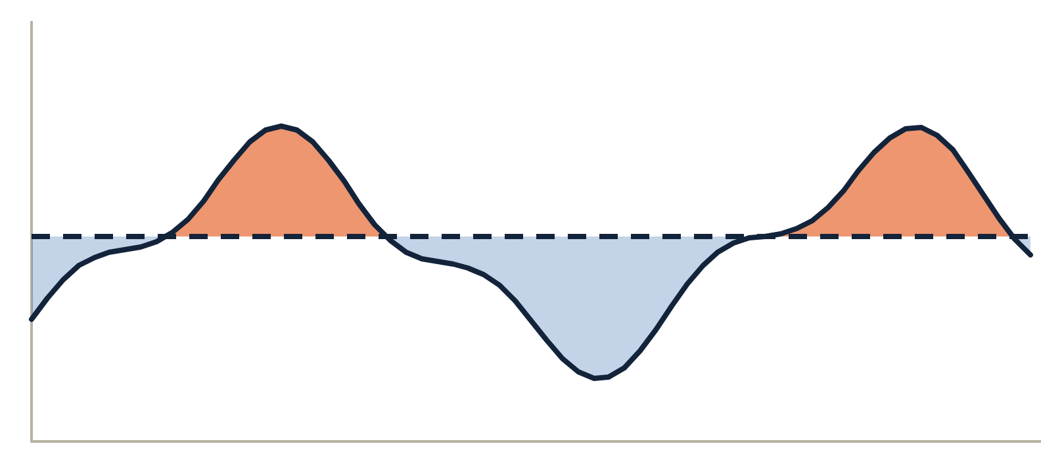
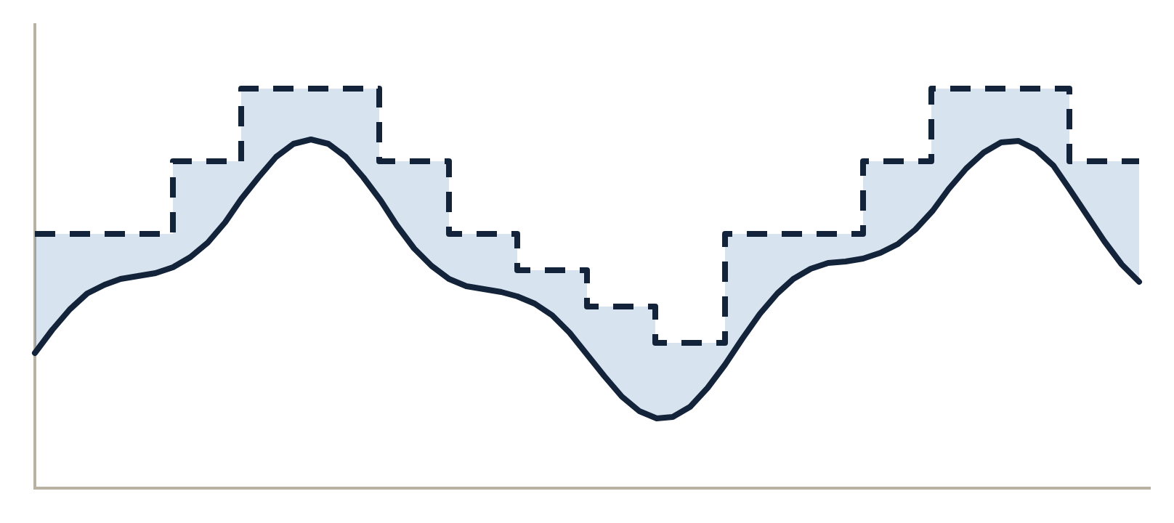
Over-, Under- and Right-Provisioning
02 · CONCEPTS OF PROVISIONING
Fixed capacity
Elastic capacity
Demand
Fixed capacity
Demand
Capacity that scales out and in
Waste — paying for idle servers (over-provisioning)
Small buffer — capacity tracks demand (right-provisioning)
Shortage — slow or failed requests (under-provisioning)
Dynamic provisioning and auto scaling make this possible.

Slide 18
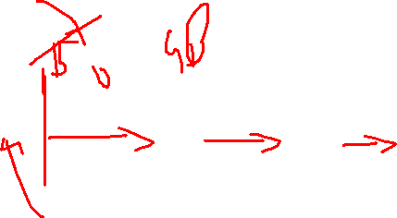
Thin vs Thick Provisioning
02 · CONCEPTS OF PROVISIONING
Example: a 100 GB virtual disk that currently holds 20 GB of data.
Thick provisioning
The full size is allocated when the disk is created.
20 GB used
80 GB reserved but unused
100 GB taken
Pro: predictable performance; the space is guaranteed. Con: unused space is locked away.
Thin provisioning
Space is allocated only as data is written.
20 GB used
grows on demand as data is written
20 GB taken
Pro: saves storage and allows over-commit. Con: the datastore can fill up if every disk grows, so capacity must be monitored.
Where you meet it: VMware vSphere disks (thick lazy-zeroed, thick eager-zeroed, thin), SAN storage arrays and many cloud disk types.

Slide 19
Why Provisioning Should Be Exclusive
03
PART 03
One owner for every resource — and three reasons it matters

Slide 20
03 · THE PRINCIPLE
One resource, one owner.
Every piece of infrastructure should be created, changed and destroyed by exactly one definition, one tool and one pipeline — never by hand, and never by a second tool.

Slide 21
Three Reasons Provisioning Should Be Exclusive
03 · WHY PROVISIONING SHOULD BE EXCLUSIVE
1
2
3
Reproducibility
Consistency
Accountability
If code is the only way resources are made, any environment can be rebuilt from scratch — after a failure, in a new region, or as a fresh test copy.
One owner means no conflicting changes and no drift: what the code says is exactly what is running.
Every change is a reviewed commit that records who, what, when and why — and nobody needs admin rights in production.
Without it: “snowflake” servers that nobody can rebuild.
Without it: a console fix is silently reverted, or two tools keep undoing each other’s changes.
Without it: untracked changes, security gaps and failed audits.

Slide 22






Keeping Provisioning Exclusive
03 · WHY PROVISIONING SHOULD BE EXCLUSIVE
One source of truth
Only the pipeline writes
One state per resource
Definitions live in Git, and every change goes through a pull request.
The CI/CD role can create and change resources; people get read-only access in production.
Remote state with locking, and never two configurations managing the same resource.
Separate environments
Detect drift
Label ownership
Dev, test and production live in separate accounts or projects, each with its own state.
Run terraform plan on a schedule and alert when reality no longer matches the code.
Tag every resource with its owning team and managed-by = terraform.

Slide 23
Configuration Management
04
PART 04
What it is · The desired-state loop · Push vs pull · Tools · Benefits and limits

Slide 24
What Is Configuration Management?
04 · CONFIGURATION MANAGEMENT
IN DEVOPS
Configuration management tools “manage the configuration of systems and the services that they provide entirely through code.”
IN SOFTWARE ENGINEERING
Identifying and controlling changes to configuration items over their whole life. Four activities:
— Carlos Nuñez, Thoughtworks (2017)
Identification: name and version every item
Control: approve changes before they happen
Status accounting: record what changed, and when
Audit: check that reality matches the records
They keep every server in a known, desired state. Typical things they manage:
Packages
Files and templates
Users and groups
Services
Permissions
Scheduled jobs
Security baselines

Slide 25



The Desired-State Loop
04 · CONFIGURATION MANAGEMENT
Repeat on every run — e.g. every 30 minutes
STEP 1
STEP 2
STEP 3
Declare
Compare
Converge
Write the desired state as code and commit it to Git.
Check each machine’s actual state against the code.
Change only what differs, then report what changed.
the next run puts it back
Drift
Someone edits a config file by hand.
Pull tools such as Puppet and Chef run this loop on a timer; push tools such as Ansible run it when you trigger them.

Slide 26



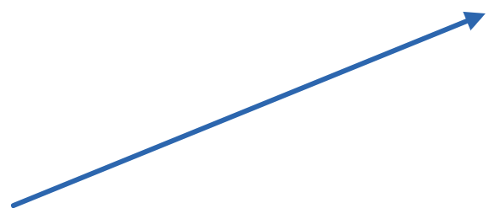
Push vs Pull Models
04 · CONFIGURATION MANAGEMENT
Push
e.g. Ansible, Salt
Pull
e.g. Puppet, Chef, CFEngine
Server 1
Agent 1
Control node
Server 2
Agent 2
Puppet server
Server 3
Agent 3
A control node connects to each server over SSH and pushes changes when you run it. No agent to install.
An agent on each server asks the central server for its configuration on a schedule, then applies it. Drift is fixed automatically.

Slide 27
Configuration Management Tools
04 · CONFIGURATION MANAGEMENT
Tool | Since | Language | Agent | Model | Style
Ansible | 2012 | YAML playbooks | None (SSH / WinRM) | Push | Procedural
Puppet | 2005 | Puppet DSL | Puppet agent | Pull | Declarative
Chef | 2009 | Ruby DSL | Chef client | Pull | Procedural
Salt | 2011 | YAML + Jinja | Salt minion, or salt-ssh | Push | Declarative
CFEngine | 1993 | Own policy language | cf-agent | Pull | Declarative
HOW TO CHOOSE
No agents to install, quick to start
Large fleets that correct themselves on a schedule
Event-driven automation at very large scale
Ansible
Salt
Puppet or Chef

Slide 28
One Task, Three Tools: Install and Run Nginx
04 · CONFIGURATION MANAGEMENT
ANSIBLE
PUPPET
CHEF
playbook.yml · YAML · push
nginx.pp · Puppet DSL · pull
default.rb · Ruby DSL · pull
- hosts: web
become: true
tasks:
- name: Install nginx
ansible.builtin.apt:
name: nginx
state: present
- name: Start nginx
ansible.builtin.service:
name: nginx
state: started
enabled: true
package { 'nginx':
ensure => installed,
}
service { 'nginx':
ensure => running,
enable => true,
require => Package['nginx'],
}
package 'nginx'
service 'nginx' do
action [:enable, :start]
end
Each one is idempotent: run it a second time and nothing changes, because Nginx is already installed and running.

Slide 29
Benefits and Limits of Configuration Management
04 · CONFIGURATION MANAGEMENT
BENEFITS
LIMITS
Consistency: every server in a role is set up the same way.
Speed: configure hundreds of servers in one run.
Learning curve: each tool has its own language and concepts.
Fewer errors: no commands typed by hand.
Living documentation: the code shows how each server is built.
Agents to run: agent-based tools need software on every server.
Fast recovery: rebuild a failed server from code.
Compliance: reviewed, logged changes and enforced baselines.
Secrets need care: passwords and keys belong in a vault, not in plain files.
Weak at creating infrastructure: no record of what already exists. That is Part 05.
In DevOps, the same configuration code flows through dev, test and production, so what passed testing behaves the same in production.

Slide 30
Why Provisioning Is Not Configuration Management
05
PART 05
Different jobs, different tools — and how they work together

Slide 31
Provisioning vs Configuration Management
05 · PROVISIONING IS NOT CONFIGURATION MANAGEMENT
Aspect | Provisioning | Configuration management
Question it answers | Does the infrastructure exist? | Is each machine set up correctly?
Works on | Networks, VMs, storage, load balancers, DNS | Packages, files, users and services inside the OS
When it runs | When infrastructure is created, changed or destroyed | Throughout each machine’s life
Tracks what exists? | Yes: a state file maps code to real resources | No: it inspects each machine when it runs
Typical tools | Terraform, OpenTofu, CloudFormation, Bicep | Ansible, Puppet, Chef, Salt
“Provisioning is not the same thing as configuration management, but they are both steps in the deployment process.”
— Red Hat, “What is provisioning?”

Slide 32



An Analogy: Running a Hotel
05 · PROVISIONING IS NOT CONFIGURATION MANAGEMENT
PROVISIONING
CONFIGURATION
DEPLOYMENT
Building the rooms
Housekeeping
The guest checks in
Walls, power, water and Wi-Fi are put in, and each room gets a number.
Every room is set to the same standard, and reset each day if a guest moves things around.
The guest arrives with their luggage, and the room starts doing its job.
In IT: Terraform creates the VMs, network and DNS.
In IT: Ansible installs packages and undoes drift.
In IT: the pipeline ships version 2.4 of the app.
And de-provisioning? Taking a room out of service for renovation: it is cleared, and its keys are cancelled.

Slide 33
Why CM Tools Struggle to Provision
05 · PROVISIONING IS NOT CONFIGURATION MANAGEMENT
Goal: grow the database tier from 2 servers to 3.
THREE REASONS
TODAY
CM TOOL, NO STATE
PROVISIONING TOOL
No state: CM tools don’t record what they created, so they can’t tell what already exists.
Two servers running
Runs “create 3 DB servers”
Checks state, plans 1 to add
db-1
db-1
db-1
db-2
db-2
db-2
No easy rollback: undoing a half-finished change needs extra code or manual clean-up.
db-3 · new
db-3 · new
db-4 · unwanted
3 servers, as intended
Tangled dependencies: networks, disks and regions must be created in order.
db-5 · unwanted
5 servers: 2 too many
Example adapted from Carlos Nuñez, “Why Configuration Management and Provisioning are Different”, Thoughtworks (2017)

Slide 34

Better Together: Provision, Then Configure
05 · PROVISIONING IS NOT CONFIGURATION MANAGEMENT
Path A · configure after launch
TERRAFORM
OUTPUTS
ANSIBLE
Creates the network, VMs and load balancer
Server IP addresses become the Ansible inventory
Installs packages, writes config, starts services
Path B · bake an image first (immutable)
PACKER + ANSIBLE
TERRAFORM
RESULT
Bake a ready-to-run machine image
Launches servers from that image
Servers boot ready, with nothing left to configure
“Provisioners are a Last Resort”
Terraform can run scripts on new machines, but its own documentation recommends cloud-init, pre-built images or a configuration management tool instead.
— Terraform documentation, HashiCorp

Slide 35
Provisioning Tools and Test Machines
06
PART 06
Terraform and friends · Disposable machines for safe testing

Slide 36
Provisioning Tools at a Glance
06 · PROVISIONING TOOLS AND TEST MACHINES
ANY CLOUD
ONE CLOUD
IMAGES AND MACHINES
Terraform
AWS CloudFormation
Packer
HCL · state file
YAML or JSON
HCL
Providers for almost any cloud or API
AWS-native stacks; AWS keeps state
Golden images for many platforms
OpenTofu
AWS CDK
Vagrant
HCL · MPL 2.0
TypeScript, Python, Java
Ruby (Vagrantfile)
Open-source fork, Linux Foundation
Code that generates CloudFormation
Local VMs for development and testing
Pulumi
Azure Bicep
cloud-init
Python, TypeScript, Go, C#
Bicep
YAML (cloud-config)
IaC in a general-purpose language
Azure-native; compiles to ARM JSON
Sets up a new VM on its first boot
Licensing: since 2023, Terraform uses the Business Source License; OpenTofu continues the code under the open-source MPL 2.0.

Slide 37
Terraform Workflow
06 · PROVISIONING TOOLS AND TEST MACHINES
terraform init
main.tf
Download providers and set up the state backend
provider "aws" {
region = "ap-south-1" # Mumbai
}
resource "aws_instance" "web" {
ami = "ami-xxxxxxxx"
instance_type = "t3.micro"
tags = {
Name = "web-01"
}
}
terraform plan
Preview what will be added, changed or destroyed
terraform apply
Make the changes and record them in state
terraform destroy
Remove everything this configuration manages
The state file is Terraform’s record of what it created. It powers plan, safe updates and exclusive ownership.
$ terraform plan
Plan: 1 to add, 0 to change, 0 to destroy.

Slide 38
Test Machines for Provisioning
06 · PROVISIONING TOOLS AND TEST MACHINES
Test provisioning code on disposable machines — never on production first.
Option | Examples | Start-up | How realistic? | Cost
Local virtual machines | VirtualBox, VMware or Hyper-V, run by Vagrant | Minutes | High: a full OS with its own kernel | Free on your laptop
Containers | Docker or Podman, often with Molecule | Seconds | Medium: shared kernel, fewer services | Free
Cloud sandbox | A separate test account or project | Minutes | Highest: the real cloud APIs | Pay per use; destroy when done
Tip: run quick checks in containers, and a full run on a VM or cloud sandbox before production.

Slide 39
Vagrant: Disposable Test Machines
06 · PROVISIONING TOOLS AND TEST MACHINES
EVERYDAY COMMANDS
Vagrantfile
Vagrant.configure("2") do |config|
config.vm.box = "bento/ubuntu-24.04"
config.vm.hostname = "web-test"
config.vm.network "private_network", ip: "192.168.56.10"
config.vm.provider "virtualbox" do |vb|
vb.memory = 2048
vb.cpus = 2
end
config.vm.provision "ansible" do |ansible|
ansible.playbook = "site.yml"
end
end
vagrant up
Create the VM and run the provisioner on first boot
vagrant provision
Re-run the provisioner on the running VM
vagrant ssh
Log in and check the result by hand
vagrant destroy -f
Delete the VM; the next vagrant up starts clean
Vagrant can provision with shell scripts, files, Ansible, Chef, Puppet, Salt and Docker.

Slide 40



The Test Loop: Create, Provision, Verify, Destroy (SDET)
06 · PROVISIONING TOOLS AND TEST MACHINES
STEP 1
STEP 2
STEP 3
STEP 4
Create (SP)
Provision (Resource)
Verify
Destroy
Launch a clean, throwaway machine.
Apply the code you are testing.
Check the result automatically.
Throw it away; start clean next time.
vagrant up
docker run
terraform apply
ansible-playbook
puppet apply
chef-client
InSpec
Goss
Testinfra
vagrant destroy
terraform destroy
Repeat for every change to the code
FRAMEWORKS THAT RUN THE WHOLE LOOP
Molecule · Ansible
Test Kitchen · Chef
Terratest · Terraform
molecule test
kitchen test
go test

Slide 41
Deployment
07
PART 07
What it is · Strategies · How it relates to provisioning

Slide 42
What Is Deployment?
07 · DEPLOYMENT
Deployment is the process of installing a specific version of an application on its target environment and making it ready to serve users. Continuous Deployment – Deploy =Release
THE USUAL PATH OF A RELEASE
Development
Test
Staging (UAT+CDelivery)
Production
Deploy
Release
Put a new build on the servers. A technical step, ideally automated by a pipeline.
Expose it to users. With feature flags or blue-green, you can deploy now and release later.

Slide 43
Deployment Strategies
07 · DEPLOYMENT
Recreate
Rolling
Blue-green
Canary
v2
v2
v1
v1
v1
v1
v2
v2
v1
v1
v1
v2
Mid-deploy: nothing is running
Mid-deploy: half replaced
Traffic switched to green (v2)
Mid-deploy: a small share on v2
Stop every v1 instance, then start v2.
Replace instances a few at a time.
Run v2 in a second, identical environment, then switch traffic.
Send a little traffic to v2 first, then increase it.
Pro: no downtime.
Con: v1 and v2 run side by side for a while.
Pro: instant rollback.
Con: double the infrastructure, provisioned on demand.
Pro: simple.
Con: downtime.
Pro: limits the blast radius.
Con: needs good monitoring.

Slide 44

How Deployment Relates to Provisioning
07 · DEPLOYMENT
Provision
Configure
Deploy/Release
Operate/Monitoring
De-provision
HOW OFTEN EACH HAPPENS (ILLUSTRATIVE)
Provisioning
Rarely: when the infrastructure changes
Configuration
Regularly: each change, plus re-checks
Deployment
Often: every release
Deployment depends on provisioning: no infrastructure, nothing to deploy to.
Outputs become inputs: IP addresses, endpoints and credentials feed the deployment.
Immutable setups merge them: each deployment provisions fresh servers.

Slide 45
Provisioning, Configuration and Deployment Compared
07 · DEPLOYMENT
Aspect | Provisioning | Configuration management | Deployment
Question | Does the infrastructure exist? | Is each machine set up correctly? | Is the right app version running?
Works on | Accounts, networks, VMs, storage, DNS | OS packages, files, users, services | Application builds and their settings
How often | Rarely: when infrastructure changes | Each change, plus regular re-checks | Often: every release
Typical tools | Terraform, CloudFormation, Bicep | Ansible, Puppet, Chef, Salt | Jenkins, GitHub Actions, Argo CD, Helm
Hotel analogy | Building the rooms | Housekeeping | The guest checks in
“Once a system has been provisioned, the next step is to configure the system and maintain it consistently over time.” — Red Hat

Slide 46



End-to-End Example: Launching an Online Store
07 · DEPLOYMENT
1 · PROVISION
2 · CONFIGURE
3 · BUILD
4 · DEPLOY
5 · OPERATE
Terraform
Ansible
CI pipeline
Rolling update
Monitoring
VPC, subnets, three VMs, a load balancer and a managed database
Java runtime, Nginx, users, firewall rules and OS hardening
Compile, run the tests and package store version 2.3
Ship version 2.3 to the VMs behind the load balancer
Dashboards and alerts on traffic, errors and response times
Diwali sale coming? Change the Terraform code and provision more servers.
Each stage has its own tool and its own owner, and each can be repeated without redoing the others.

Slide 47
Activity: Provision, Configure or Deploy?
REVIEW · CLASSROOM ACTIVITY
Label each task P (provision), C (configure) or D (deploy). Then discuss: which tasks could fit two labels?
1
Create a VPC with two subnets in ap-south-1
2
Install Nginx and Java on 40 web servers
3
Roll out version 2.4 of the checkout service
4
Attach a 200 GB disk to the database server
5
Disable root SSH login on every server
6
Switch live traffic from blue to green
7
Launch three VMs behind a load balancer
8
Add a “deploy” user with an SSH key to all servers
Notes:
Answer key: 1 P, 2 C, 3 D, 4 P, 5 C, 6 D, 7 P, 8 C. Discussion points. Task 8 is configuration management on the servers, but in identity terms it is also user provisioning. Task 4 is storage provisioning, although formatting and mounting the disk inside the OS is configuration. Task 6 is a deployment (release) step, but it only works because the green environment was provisioned first.

Slide 48
Check Your Understanding
REVIEW · QUIZ
1
What is the basic definition of provisioning, and what is its software definition?
2
Give three reasons why provisioning should be exclusive.
3
Why is a configuration management tool a poor choice for creating cloud infrastructure?
4
Which model, push or pull, does Ansible use? Which does Puppet use?
5
Why does a blue-green deployment depend on provisioning?
Notes:
Answer key. 1. Basic definition: supplying something with everything it needs before it is used, like provisioning a ship before a voyage. Software definition (Red Hat): “the process of creating and setting up IT infrastructure, and includes the steps required to manage user and system access to various resources.” 2. Reproducibility: any environment can be rebuilt from code. Consistency: no conflicting changes and no drift. Accountability: every change is reviewed and logged, and people need no admin rights in production. 3. CM tools keep no state of what they created, so they cannot tell what already exists (asking for 3 database servers when 2 exist can produce 5). Rollbacks need extra code, and dependencies between resources get complicated. Provisioning tools keep state, plan changes and handle dependencies. 4. Ansible pushes: it is agentless and connects over SSH when you run it. Puppet pulls: agents check in with the Puppet server on a schedule (every 30 minutes by default). 5. Blue-green needs a second, identical environment to deploy the new version into before traffic is switched. That environment has to be provisioned, ideally from code and on demand, and de-provisioned afterwards.

Slide 49
Glossary
REVIEW · KEY TERMS
Provisioning
De-provisioning
Creating and setting up infrastructure and access, ready for use.
Removing resources and revoking access when no longer needed.
Infrastructure as Code (IaC)
Declarative vs imperative
Defining infrastructure in versioned, machine-readable files.
Describe the end state, vs list the steps to get there.
Idempotent
Configuration drift
Running it again changes nothing if the state is already right.
The gap that grows when real systems stop matching their code.
Agent vs agentless
State file
Software on each node pulls its config, vs a control node pushes it.
A provisioning tool’s record linking code to real resources.
Golden image
Blue-green and canary
A tested machine image used to launch identical servers.
Switch to a second environment, vs send a little traffic first.

Slide 50
Key Takeaways
REVIEW · SUMMARY
01
Provisioning creates the infrastructure and access. Configuration management sets up what runs on it. Deployment ships the application.
02
03
Automate provisioning as code: declarative, idempotent and version-controlled.
Keep provisioning exclusive, one owner per resource, for reproducibility, consistency and accountability.
04
05
Use each tool for its job, and test on disposable machines before production.
Deployment depends on provisioning; with immutable infrastructure, every deployment provisions fresh servers.

Slide 51
Further Reading
REVIEW · SOURCES AND FURTHER READING
Red Hat
NIST SP 800-145
What is provisioning?
The NIST Definition of Cloud Computing
Thoughtworks · Carlos Nuñez
HashiCorp · Terraform docs
Why Configuration Management and Provisioning are Different
Provisioners are a last resort
HashiCorp · Vagrant docs
Ansible
Provisioning test machines with Vagrant
Ansible documentation
Martin Fowler
Blue-green deployment
Questions?

